Slide 1
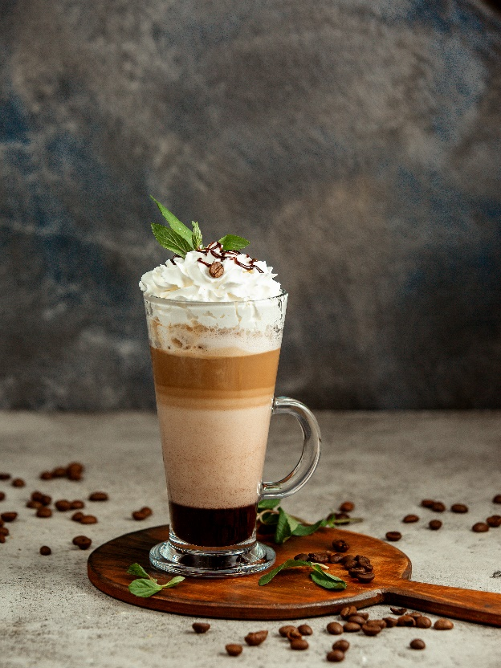
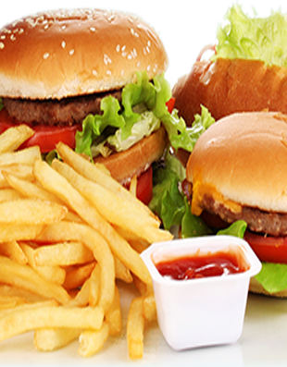
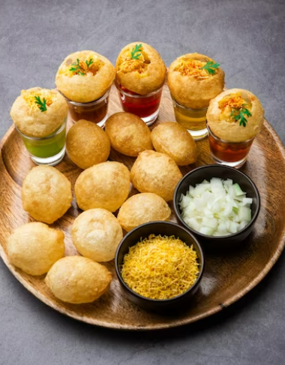
Restaurant Sales
Learner : Sakshi Laxman Waghmare
Guide : Shruti Gode
Notes:
NOTE: To replace a picture, just select and delete it. Then use the Insert Picture icon to replace it with one of your own!

Slide 2
Business Objectives
The restaurant wants to study sales trends and figure out what food customers like the most. This analysis will help them stock up on those popular items at the right times, making their sales better in the future.
Analyse sales trends over time.
Understand customer preferences for different items.
Evaluate the impact of payment methods on revenue.
Investigate the performance of staff members based on gender.
Explore the popularity of items at different times of the day.
1
2
3
4
5

Slide 3
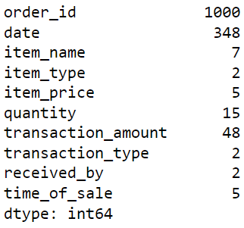
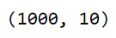
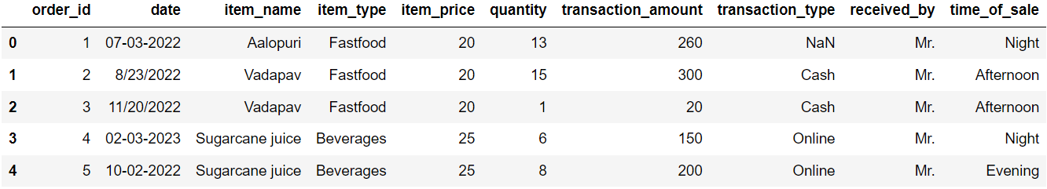
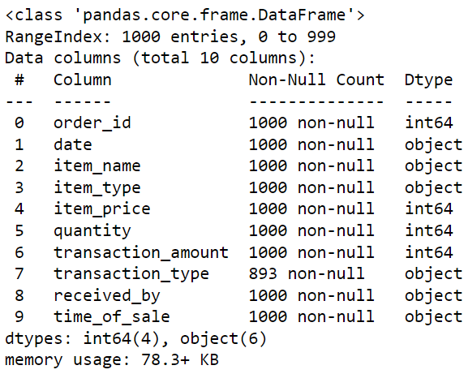
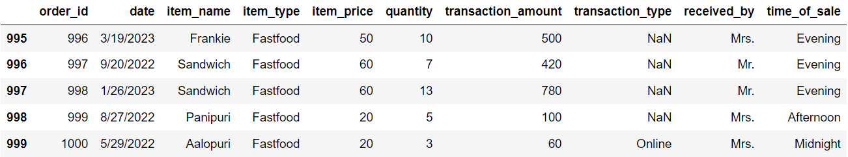
Data understanding
Unique Records
Number of rows & Columns
First five rows
Data Information
Last five rows

Slide 4
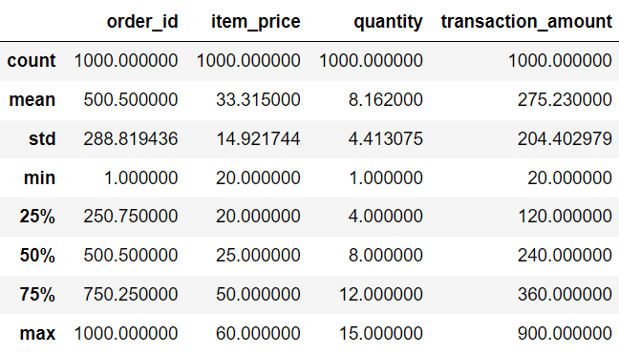
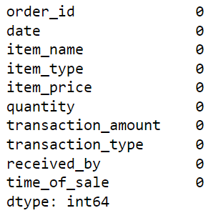
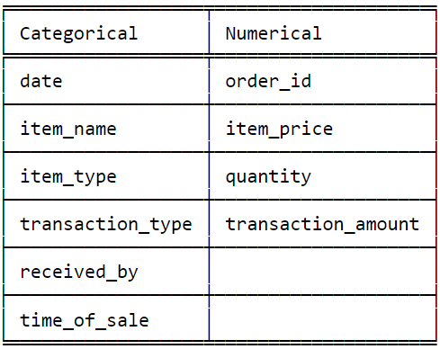
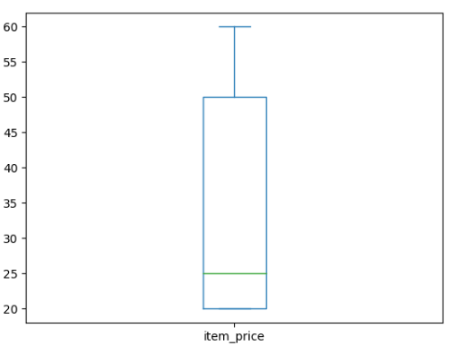
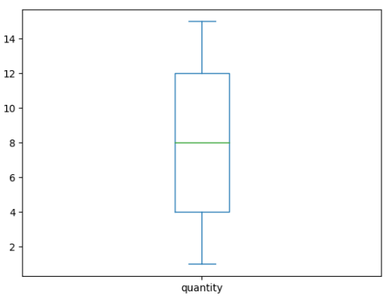
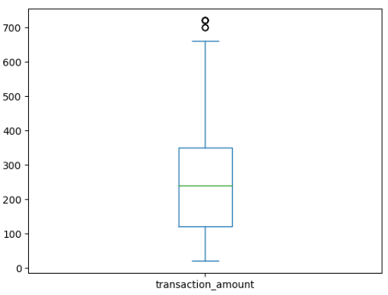
Data Pre-Processing
Summary Statistics
Missing values
Column Category
Item Price
Quantity
Transaction Amount
Note : Outliers in the transaction amount column have been removed, as evident from the visual comparison between the data before and after the removal. However, a few outliers still persist in the dataset. Box plot is visual representation of data it has less accuracy than IQR method.

Slide 5
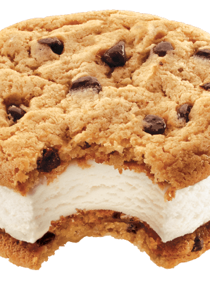
Data Visualization

Slide 6
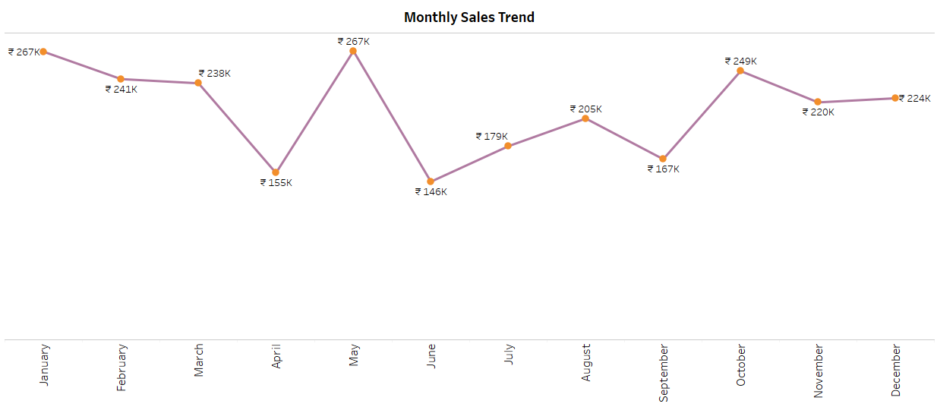
Sales Trend Over Time
Interpretation :
During the month of May, sales experience a significant peak, with notable increases observed during holiday periods and festive seasons such as Diwali, Christmas, and the New Year.

Slide 7
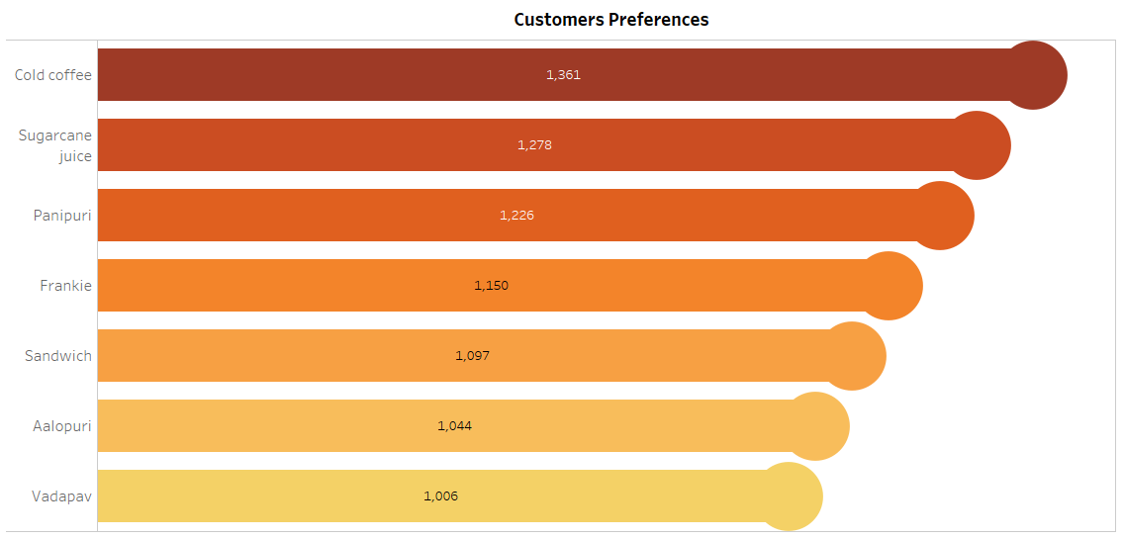
Customer preferences for different Items
Interpretation :
Most customers prefer ordering cold coffee and sugarcane juice, and there is also a high demand for pani puri.

Slide 8
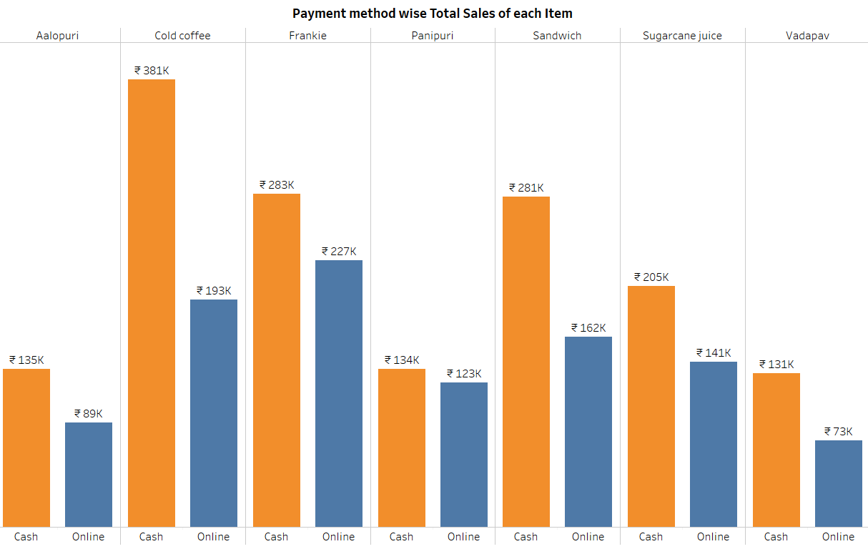
Payment method Impact on Revenue
Interpretation :
The majority of customers tend to settle their bills primarily using cash as their preferred mode of payment.

Slide 9
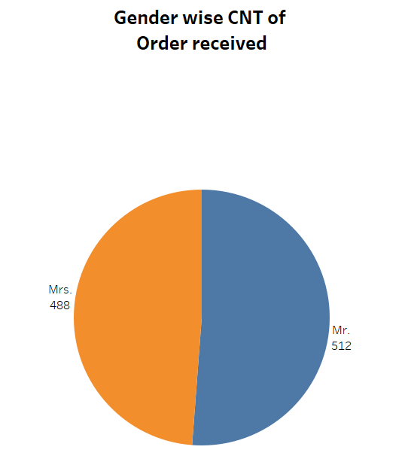
Gender wise Staff Performance
Interpretation :
There were 488 orders received by female staff and 512 orders received by male staff.

Slide 10
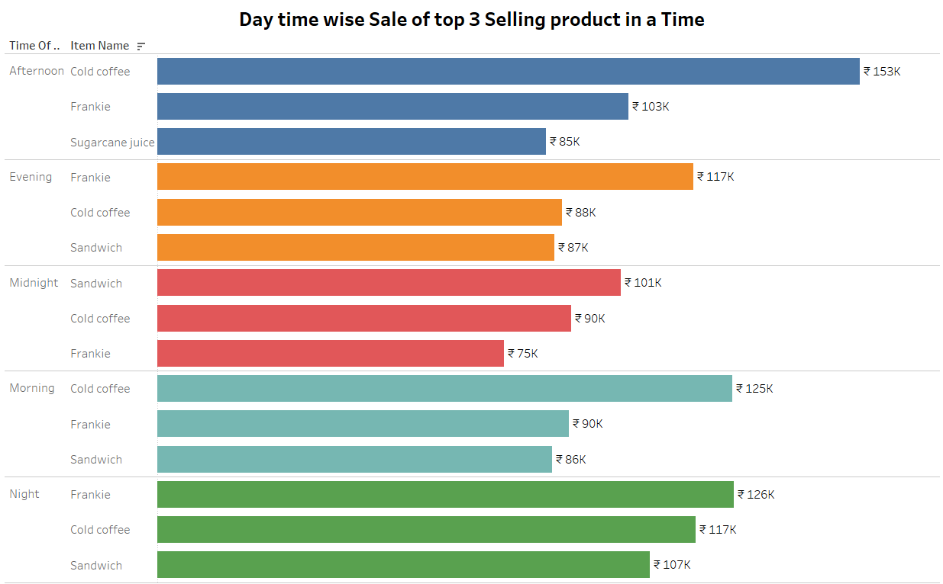
Popularity of items at Different Times in a Day
Interpretation :
Cold coffee and Frankie are the most preferred items throughout the day.

Slide 11
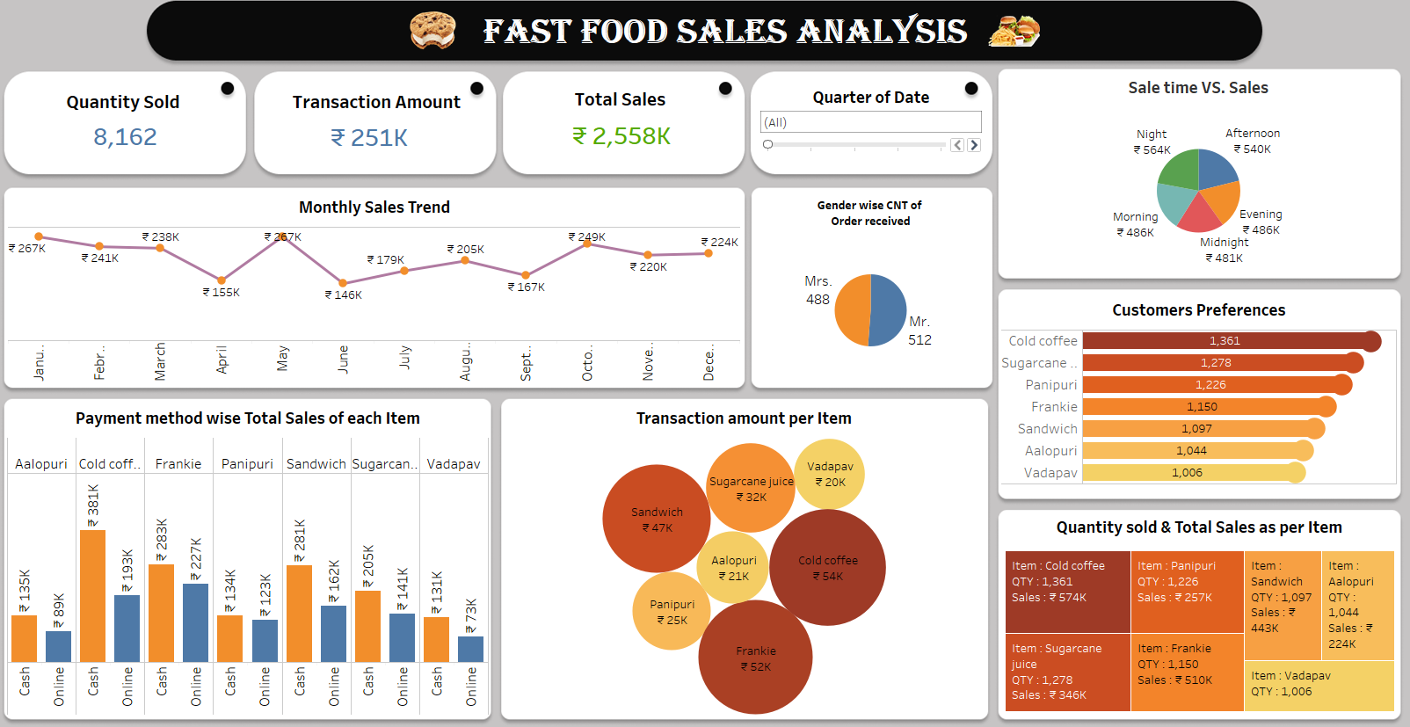
Blank slide

Slide 12
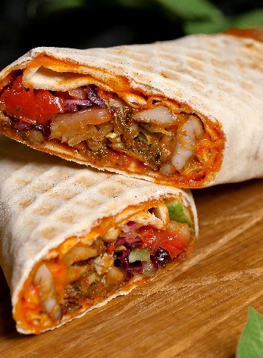
Recommendation
During the month of May, sales experience a significant peak, with notable increases observed during holiday periods and festive seasons such as Diwali, Christmas, and the New Year. For effective inventory management, the restaurant should consider stocking up on specific food items based on customer preferences at different times of the day:
At the morning time, popular choices include Cold Coffee, Sandwich, and Panipuri.
Afternoons more preference is for Cold Coffee and Sugarcane.
At the evening time, people really enjoy having Sugarcane and Panipuri.
At night, people particularly like to have Cold Coffee, Sandwich, and Frankie.
Panipuri sales are highest during midnight
The preferred item for most customers is cold coffee, and they choose to pay their bills using cash. The male staff received a higher number of orders compared to the female staff, indicating strong performance by the male team.

Slide 13
